Slide 1
Introductory Programming and Problem-Solving Skills
DATA AND EXPRESSION
Week - 2
Basanta Singh

Slide 2
Navigation 1. Let’s Recap
1. Let’s Recap
Module Structure
How to think like computer?
Problem Solving Skills
Algorithm, Flowchart and Pseudo code
Introduction Python
The IDLE Editor
Python Standard Library

Slide 3
Navigation Let’s Recap 1.1 Researched?
1.1 Researched?
What is variable?
What is arithmetic operator?
How To Take Input From User?
How To Display Output To The User?

Slide 4
Navigation Let’s Recap 1.1 Researched? 1.2 Variable
1.2 Let’s Discuss!!
What is variable?
A variable is “a name that assigned to a value”, as shown below.
n = 50 Variable n is assigned the value 50
Now, whenever variable n appears in a calculation, it is the value of n is that is used:
n + 20 (50 + 20)

Slide 5
Navigation Let’s Recap 1.1 Researched? 1.2 Variable 1.3 Arithmetic Operator
1.2 Let’s Discuss!!
What is arithmetic operator?
Arithmetic Operators are operators (symbols) used to perform mathematical calculations.
Addition, subtraction, and division use standard mathematical notation. For example, 2+5, 5-2, 4/2.
Multiplication and exponential (*) can used.
For example,
5 * 10 (5 times 10),
2** 4 (2 to the 4th power.)

Slide 6
Navigation Let’s Recap 1.1 Researched? 1.2 Variable 1.3 Arithmetic Operator 1.4 Basic Input
1.4 Let’s Discuss!!
How To Take Input From User?
The program that we will request and get information from the user. In Python, the input function is used for this purpose.
name = input('What is your name?: ')
Characters within quotes are called Strings. This particular use of a string, for requesting input from the user, is called a prompt.
The input function displays the string on the screen to prompt the user for input,
What is your name?: Jeffrey

Slide 7
Navigation Let’s Recap 1.1 Researched? 1.2 Variable 1.3 Arithmetic Operator 1.4 Basic Input 1.5 Basic Output
1.5 Let’s Discuss!!
How To Display Output To The User?
The print function is used to display information on the screen in Python.
>>> print ('Welcome to My First Program!')
Welcome to My First Program!
or used to output the value of a variable you have defined:
>>> n = 10
>>> print(n)
10
We will learn more about variables, operators, and input/output in further slides.

Slide 8
Data and Expression

Slide 9
Navigation Let’s Recap 1.1 Researched? 2. Introduction
2. Introduction
The generation, collection, and analysis of data is driving force in today’s world. The sheer amount of data is being created is immense.
01
For instances
- Chain stores generates terabytes of customer information, looking for shopping patterns
- Facebook users have created 40 billion photos requiring more than a petabyte of storage.
[Interesting Fact]: The amount of data created each year is estimated to be almost to zetabytes (10²¹ or 1,000,000,000,000,000,000,000 bytes), more than doubling every two years
Today, we will explore how data is represented and manipulated in Python.

Slide 10
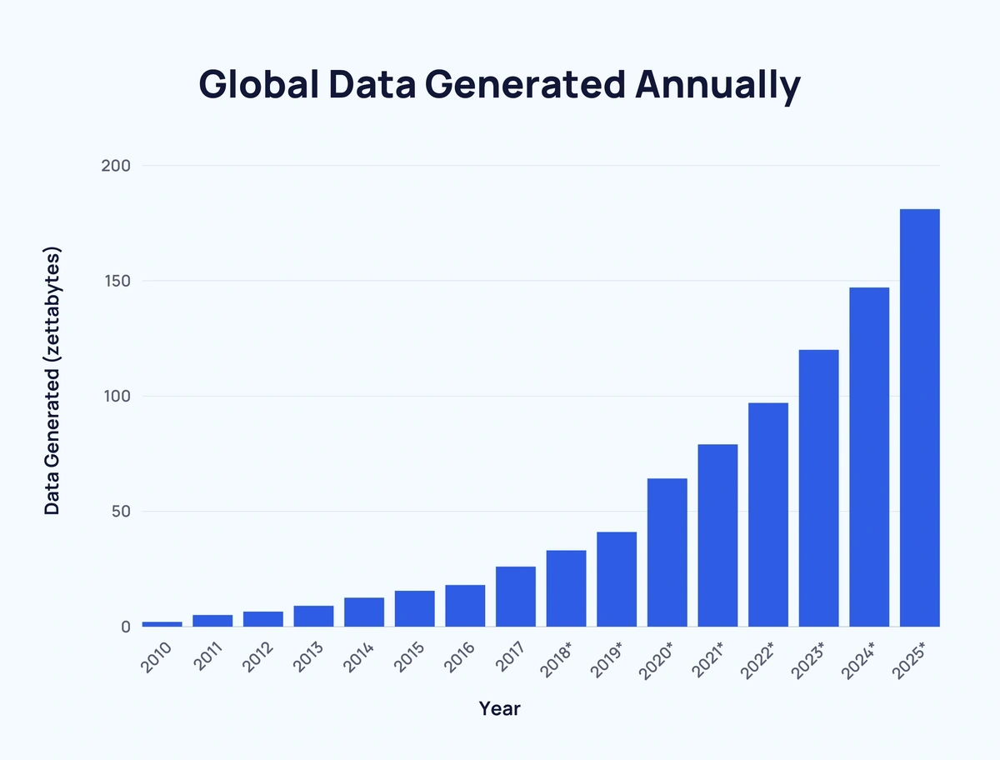

Slide 11
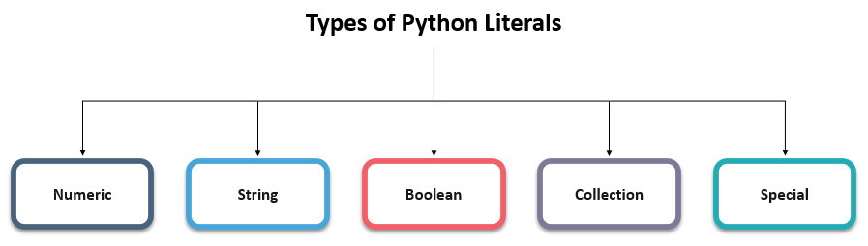
Navigation Let’s Recap 1.1 Researched? 2. Introduction 3. Literals
3. Literals
To take something literally is to take it at “face value”. The same is true of literals in programming.
01
Literals [Definition]: A literal is a sequence of one or more characters that stands for itself such as the literal 12.
In Python, literals are the raw data that is assigned to variables or constants during programming.

Slide 12
Navigation Let’s Recap 1.1 Researched? 2. Introduction 3. Literals 3.1 Numeric Literal
3.1 Numeric Literals
[Definition]: A numeric literal is a literal containing only the digit 0-9, an optional sign characters (+ or -), and a possible decimal point. (The letter e is also used in exponential notation, shown next)
01
Floating Point [Definition]: If a numeric literal contains a decimal point, then it denotes as floating-point values or commonly known as float. For example: 10.24
Integer [Definition]: If a numeric literal contains whole number then it is known to be integer. For example: 10
Note: Commas are never used in numeric literals

Slide 13
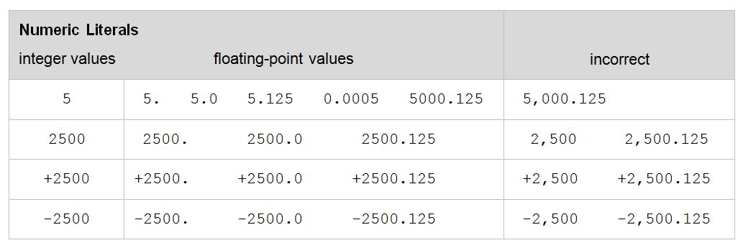
Navigation Let’s Recap 1.1 Researched? 2. Introduction 3. Literals 3.1 Numeric Literal 3.1.1 Example
3.1.1 Let’s Understand Through Example
01

Slide 14
Navigation Let’s Recap 1.1 Researched? 2. Introduction 3. Literals 3.1 Numeric Literal 3.1.1 Example 3.1.2 Try Out
3.1.2 Let’s Try!!
Which of the following are valid numeric literals in Python?
01
>>> 1024 >>> -1024 >>> .1024
>>> 1,024 >>> 0.01024 >>> 1,024.46

Slide 15
Navigation Let’s Recap 1.1 Researched? 2. Introduction 3. Literals 3.1 Numeric Literal 3.2 String Literal
3.2 String Literals
[Definition]: A string literal or “string”, represent a sequence of characters:
01
'Hello' 'Smith, John' "Baltimore, Maryland 21210"
In Python, string literals may be delimited (surrounded) by a matching pair of either single(‘’) or double(“”) quotes. String must be contained all on one line (except when delimited by triple quotes).

Slide 16
Navigation Let’s Recap 1.1 Researched? 2. Introduction 3. Literals 3.1 Numeric Literal 3.2 String Literal 3.2.1 String, Quotes
3.2.1 What’s inside quotes?
A string may contain zero or more characters, including letters, digits, special characters, and blanks.
01
A string may also be empty which is different from blank string. Empty strings consists of only a pair of matching quotes (with nothing in between) whereas blank string contains a space inside matching quotes. Both empty and blank spaces have their own uses.
Note: String may also contain quote characters as long as different quotes (single vs. double) are used to delimit the string.
'This is a "valid" string with single quotes.'
"This is a 'valid' string with double quotes."

Slide 17
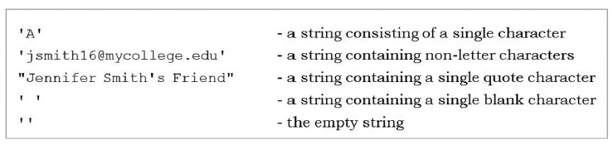
Navigation Let’s Recap 1.1 Researched? 2. Introduction 3. Literals 3.1 Numeric Literal 3.2 String Literal 3.2.1 String, Quotes 3.2.2 Example
3.2.2 Let’s Understand Through
Example
01

Slide 18
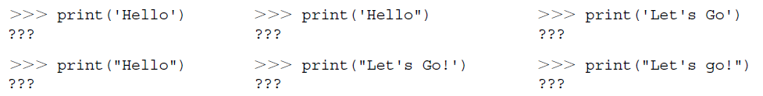
Navigation Let’s Recap 1.1 Researched? 2. Introduction 3. Literals 3.1 Numeric Literal 3.2 String Literal 3.2.1 String, Quotes 3.2.2 Example 3.2.3 Try Out
3.2.3 Let’s Try!!
01
What will be displayed by each of the following?

Slide 19
Navigation 3. Literals 3.1 Numeric Literal 3.2 String Literal 3.3 Unicode encoding scheme
How will computer understand the
characters?
The answer is Unicode encoding scheme
01
Unicode [Definition]: Unicode is actually a collection of different encoding schemes utilizing between 8 and 32 bits for each character. The default encoding Python uses UTF-8, an 8-bit encoding compatible with ASCII, an older, still widely used encoding scheme.
Currently, there are over 100,000 Unicode-defined characters for many of the languages around the world. Unicode is capable of defining more than 4 billion characters. Thus, every languages can encoded in Unicode.

Slide 20
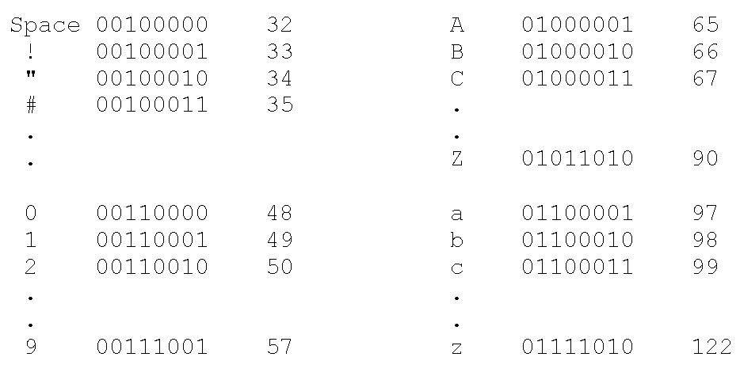
Navigation 3. Literals 3.1 Numeric Literal 3.2 String Literal 3.3 Unicode encoding scheme 3.3.1 UTF Table
3.3.1 Representing Character
Values
01
UTF-8 encoded characters that have an ordering with sequential numerical values.
For example, ‘A’ is encoded as 010000001 (65). This is also true for digit characters, ‘0’ is encoded as 48, ‘1’ as 49, etc.

Slide 21
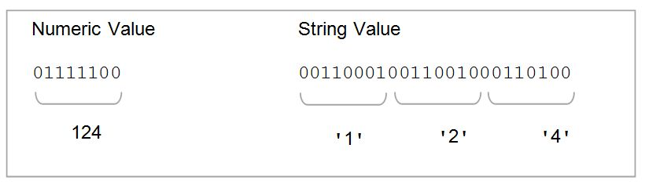
Navigation 3. Literals 3.1 Numeric Literal 3.2 String Literal 3.3 Unicode encoding scheme 3.3.1 UTF Table 3.3.2 Numeric Representation vs. String
3.3.2 Numeric Representation
Vs. String
Note the difference between a numeric representation (that can be used in arithmetic calculations) vs. a number represented as a string of digit characters (note used in calculation)
01
Explanation: Here, the binary representation of 124 is the binary number for that value. The string representation ‘124’ consists of longer sequences of bits, eight bits (one byte) for each digit.

Slide 22
Navigation 3. Literals 3.1 Numeric Literal 3.2 String Literal 3.3 Unicode encoding scheme 3.3.1 UTF Table 3.3.2 Numeric Representation vs. String 3.3.3 ord and chr
3.3.3 ord and chr Function
Python has means of converting between a character and its encoding:
01
The ord function: gives the UTF-8 (ASCII) encoding of a given character. For example,
ord('A')is 65
The chr function: gives the character for a given encoding value, thus
chr(65)is ‘A’
However, in general there is no need to know the specific encoding of a given character, there are times when such knowledge can be useful.

Slide 23
Navigation 3. Literals 3.1 Numeric Literal 3.2 String Literal 3.3 Unicode encoding scheme 3.3.1 UTF Table 3.3.2 Numeric Representation vs. String 3.3.3 ord and chr 3.3.4 Escape Character
3.3.4 What are Control Characters?
Control characters [Definition]: Special characters which are not displayed but, rather control the display of output (among other things.) Control characters do not have corresponding keyboard character, and thus are represented by a combination of characters called escape sequence.
01
Escape sequence begin with an escape character that causes the characters following to “escape” their normal meaning. The backslash (\) serves as the escape character in Python.
Hello
Basanta Singh
print ('Hello \n Basanta Singh')

Slide 24
Navigation 3. Literals 3.1 Numeric Literal 3.2 String Literal 3.3 Unicode encoding scheme 3.3.1 UTF Table 3.3.2 Numeric Representation vs. String 3.3.3 ord and chr 3.3.4 Escape Character Tryout
Let’s Try!!
01
>>> print(’Hello World’) >>> print(‘Hello\nWorld’)
>>> print(‘Hello World\n’) >>> print(‘Hello\n\nWorld’)
>>> print (‘Hello World\n\n\’) >>> print(1, ‘\n’, 2, ‘\n’, 3)
>>> print (‘\nHello World’) >>> print(‘\n’, 1, ‘\n’, 2)

Slide 25
Variables and Identifiers

Slide 26
Navigation 3. Literals 3.1 Numeric Literal 3.2 String Literal 3.3 Unicode encoding scheme 4 Variable
4 Variable, True Usefulness
So far, we have only looked at literal values in programs. However, the true usefulness of a computer program is the ability to operate on different values each time the program is executed. This is provided by the notion of variable.
01
Note: We will look at variables and identifiers next.

Slide 27

Navigation 3. Literals 4 Variable, True Usefulness 4.1 Variable?
4.1 What is Variable?
A variable is a name (identifier) that is associated with a value and can be used to store data.
01
Each variable must have a unique identifier value.
A variable can be assigned different values during program’s execution, hence the num = 10.

Slide 28


Navigation 3. Literals 4 Variable, True Usefulness 4.1 Variable? 4.2 Variable Assignment
4.2 Variable Assignment
When a variable is appears in a program (except on the left-hand side of an assignment statement), it is the value associated with the variable used, and not the variable’s name.
01
Variables are assigned values by use of the assignment operator, =

Slide 29

Navigation 3. Literals 4 Variable, True Usefulness 4.1 Variable? 4.2 Variable Assignment 4.3 Does Not Make Sense!!
4.3 Does Not Make Sense!!
Assignment statements often looks wrong to new programmers.
01
Mathematically,
num = num + 1
10 = 10 + 1
10 = 11???
Mathematically, it does not make sense. However, in programming it is used to increase value by 1 and assigned to the num variable.
Note: This can be said to increment variable

Slide 30
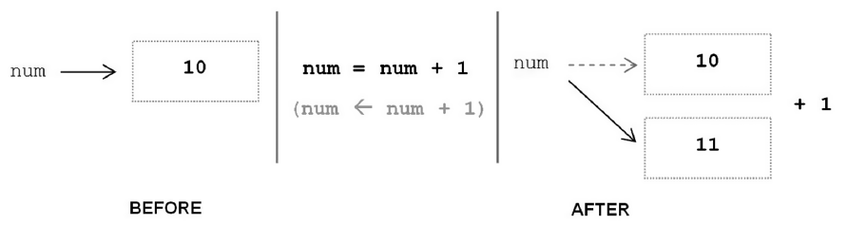
Navigation 3. Literals 4 Variable, True Usefulness 4.1 Variable? 4.2 Variable Assignment 4.3 Does Note Make Sense!! 4.4 Assignment Operator
4.4 Assignment Operator
Let think this in steps:
- The right side of the assignment is evaluated first.
- The result is assigned to variable on the left.
01
An arrow symbol is not used simply because there is no such characters on a standard computer keyboard.
There are other assignment operators as well which we use to increase or decrease the variable.

Slide 31
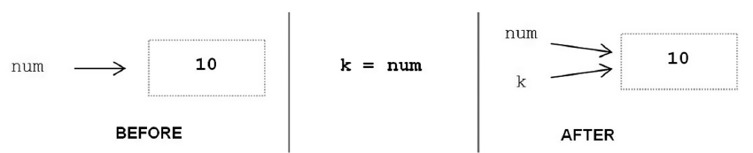
Navigation 3. Literals 4 Variable, True Usefulness 4.1 Variable? 4.2 Variable Assignment 4.3 Does Not Make Sense!! 4.4 Assignment Operator 4.5 Variable as Value
4.5 Variable as Value
Variables may also be assigned to the value of another variable:
01
Variables num and k are both associated with the same literal value 10 in memory.

Slide 32
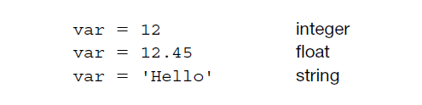
Navigation 4.3 Does Not Make Sense!! 4.4 Assignment Operator 4.5 Variable as Value 4.6 Dynamic Typing
4.6 Dynamic Typing
Finally, in Python the same variable can be associated with the values of different type during program execution:
01
The ability of a variable to be assigned values of different type is referred as dynamic typing, introduced later in a discussion on data types
Many other programming languages such as Java use static typing, in which variable must be defined at a compile time and cannot be changed at runtime.

Slide 33
Navigation 4.3 Does Not Make Sense!! 4.4 Assignment Operator 4.5 Variable as Value 4.6 Dynamic Typing 5. Identifier
5. What is an Identifier?
An identifier is a sequence of one or more characters used to provide a name for a given program element. Variable names line and num_credits are identifiers.
01
Python is case sensitive, thus Line is different from line.
The underscore character, _, can be used to aid in the readability of long identifier names. It should not be used as the first character, however as identifiers beginning with an underscore have a special meaning in Python.

Slide 34
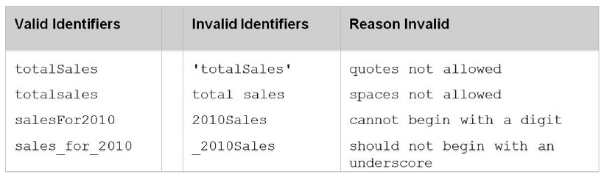
Navigation 4.3 Does Not Make Sense!! 4.4 Assignment Operator 4.5 Variable as Value 4.6 Dynamic Typing 5. Identifier 5.1 Example
5.1 Identifier Example
01
Spaces are not allowed as part of an identifier. This is a common error since some operating system allows spaces within the file names. In Python, however, spaces are used to delimit (separate) distinct syntactic entities. Thus, any identifier containing a space character would be considered two separate identifiers.

Slide 35
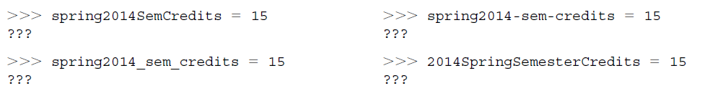
Navigation 4.3 Does Not Make Sense!! 4.4 Assignment Operator 4.5 Variable as Value 4.6 Dynamic Typing 5. Identifier 5.1 Example Tryout
3.3 Let’s Try!!
01
What is displayed by each of the following?

Slide 36
Navigation 4.3 Does Not Make Sense!! 4.4 Assignment Operator 4.5 Variable as Value 4.6 Dynamic Typing 5. Identifier 5.1 Example 5.2 Predefined words as variable identifier
Can we use and as variable?
In Python, there are various words which are predefined and have a special meaning to that name. Such words are said to be keywords and cannot be used as regular identifiers.
01
>>> and = 10
SyntaxError: invalid syntax
Since, and is a logical operator and has a special meaning in python, so when attempt to assign the identifier as and then a syntax error is thrown.

Slide 37

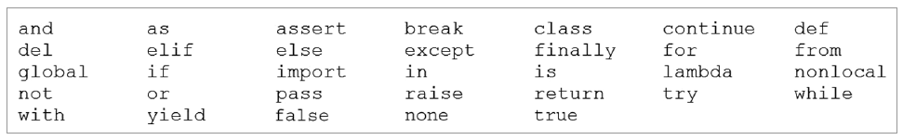
Navigation 4.3 Does Not Make Sense!! 4.4 Assignment Operator 4.5 Variable as Value 4.6 Dynamic Typing 5. Identifier 5.1 Example 5.2 Predefined words as variable identifier 5.3 Python Keywords
Python Keywords
The keywords in Python are listed below:
01
To display the keywords in python, type help() in the Python shell, then type words.
A simple way to check whether a specific identifier is keyword in Python is as follows:
>>> 'exit' in dir(__builtins__) True

Slide 38



Slide 39
Operators

Slide 40
Navigation 5. Identifier 6. Operators
6. Operators
Operator [Definition]: An operators is a symbol that represents an operation that may be performed on one or more operands.
01
Some of the operators of python are listed below:
Arithmetic Operator
Assignment Operator
Comparison Operator
Logical Operator
Identity Operator
Membership Operator
Bitwise Operator

Slide 41
Navigation 5. Identifier 6. Operators 6.1 Arithmetic Operator
6.1 Arithmetic Operators
Arithmetic Operator [Definition]: Arithmetic operators are binary operators which are used with numeric values to perform common mathematical operations.
01
Arithmetic Operators | Description | Example | Result
- X | Negation | -10 | -10
X + Y | Addition | 10 + 25 | 35
X - Y | Subtraction | 10 - 25 | -15
X * Y | Multiplication | 10 * 5 | 50
X / Y | Division | 25 / 10 | 2.5
X // Y | Truncating Division | 25 // 10 | 2
X % Y | Modulus | 25 % 10 | 5
X ** Y | Exponentiation | 10 ** 2 | 100

Slide 42
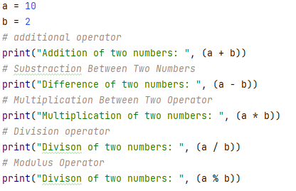
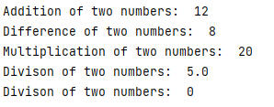
Navigation 5. Identifier 6. Operators 6.1 Arithmetic Operator Example
Let’s Understand Through Example
01
Output

Slide 43
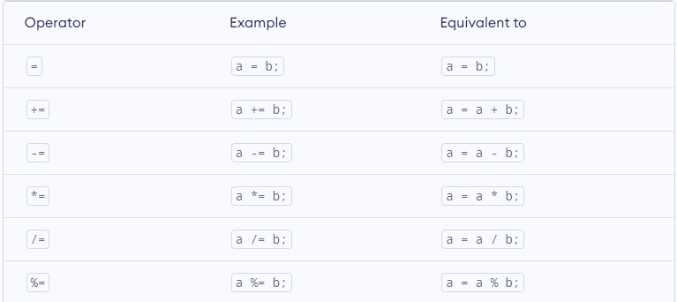
Navigation 5. Identifier 6. Operators 6.1 Arithmetic Operator 6.2 Assignment Operator
Assignment Operators
Assignment Operator [Definition]: Assignment operators are binary operators which are used to assign the value to the variable.
01
Some assignment operators

Slide 44
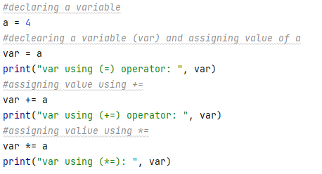

Navigation 5. Identifier 6. Operators 6.1 Arithmetic Operator 6.2 Assignment Operator Example
3.2 Let’s Understand Through Example
01
Output

Slide 45
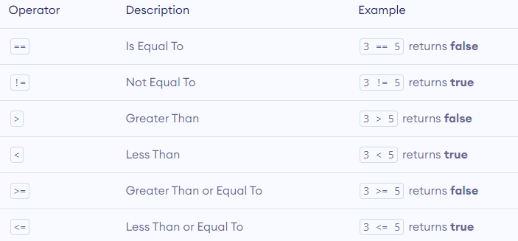
Navigation 5. Identifier 6. Operators 6.1 Arithmetic Operator 6.2 Assignment Operator 6.3 Comparison Operator
6.3 Comparison Operators
Comparison Operator [Definition]: Comparison operators are binary operators which are used to check the relationship between two operands.
01
Some comparison operators

Slide 46
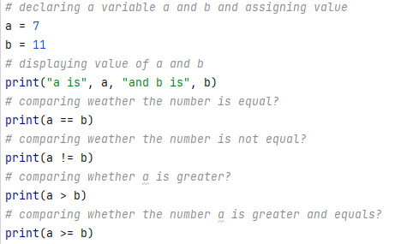
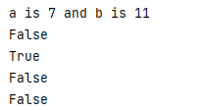
Navigation 5. Identifier 6. Operators 6.1 Arithmetic Operator 6.2 Assignment Operator 6.3 Comparison Operator Example
3.2 Let’s Understand Through Example
01
Output

Slide 47
Navigation 5. Identifier 6. Operators 6.1 Arithmetic Operator 6.2 Assignment Operator 6.3 Comparison Operator 6.4 Logical Operator
Logical Operators
Logical Operator [Definition]: Logical operators are binary operators which are used to check either the expression is true or false. Basically, they are used during the decision making scenario
01
Logical Operators | Description | Example
and | Returns true when both condition is true | x < 5 and x < 10
or | Return true when any one condition is true | x < 5 or x < 10
not | Reverse the condition result | not(x < 5 and x < 10)
logical operators

Slide 48
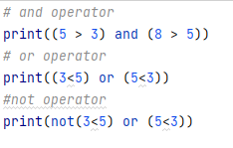

Navigation 5. Identifier 6. Operators 6.1 Arithmetic Operator 6.2 Assignment Operator 6.3 Comparison Operator 6.4 Logical Operator Example
Let’s Understand Through Example
01
Output

Slide 49
Expression and Data Types

Slide 50
Navigation 6. Operators 7 Expression
7. What is an Expression?
An expression is a combination of symbols that evaluates to a value. Expression, most commonly, consist of a combination of operators and operands. E.g. 4 + (3 * k)
01
An expression can also consist of a single literal or variable. Thus 4, 3 and k are each expression. This expression has two subexpression, 4 and (3 * k). Subexpression (3 * k) itself has two sub expression, 3 and k.
Note: Expression that evaluates to a numeric type are called arithmetic expression.

Slide 51
Navigation 6. Operators 7 Expression Tryouts
Let’s Try!!
Translate the following into Python algebraic or Boolean expressions and then evaluate them:
01
The difference between Annie’s age (25) and Ellie’s (21)
The total of £14.99, £27.95, and £19.83
The area of a rectangle of length 20 and width 15
2 to the 10th power
The minimum of 3, 1, 8, -2, 5, -3, and 0

Slide 52
Navigation 6. Operators 7 Expression 7.1 Operator Precedence
7.1 Operator Precedence
The way we commonly represent expressions, in which operators appear between their operands, is referred to as infix notation. For example, the expression 4 + 3 is in infix notation since the + operator appears between its two operands, 4 and 3. There are other ways of representing expressions called prefix and postfix notation.
01
The expression 4 + (3 * 5) is also in infix notation. It contains two operators,+ and *. The parentheses denote that (3 * 5) is a subexpression. Therefore, 4 and (3 * 5) are the operands of the addition operator, and thus the overall expression evaluates to 19.
What if the parentheses were omitted, as given below?
4 + 3 * 5

Slide 53
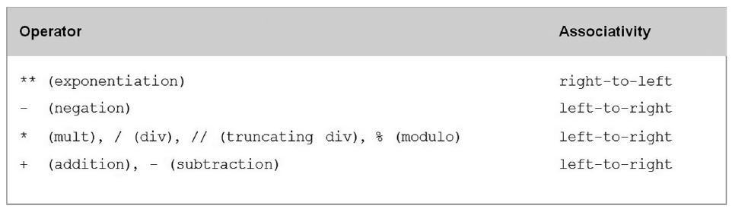
Navigation 6. Operators 7 Expression 7.1 Operator Precedence 7.2 Two Possibilities
Two Possibilities!!
4 + 3 * 5 -> 4 + 15 -> 19 4 + 3 * 5 -> 7 * 5 -> 35
01
Some might say that the first version is the correct one by the conventions mathematics. However, each programming language has its own rules for the order that operators are applied, called operator precedence. This may or may not be same as in mathematics.
Below the operator precedence table or Python operators discussed so far

Slide 54
Navigation 6. Operators 7 Expression 7.1 Operator Precedence 7.2 Two Possibilities 7.3 Data Types
7.3 Data Types
A data type is a set of values, and a set of operators that may be applied to those values. For example, integer data type consist of the set of integers, and operators for addition, subtraction, multiplication, and division among others.
01
Integer, floats and strings are part of a set of predefined data types in Python called the built-in-types. There are other built-in data types as well such Boolean, Collections and so on.
For example, it does not make sense to try to divide a string by two, 'Hello' / 2. The programmer knows this by common sense. Python knows it because 'Hello' belongs to the string data type, which does not include the division operation.

Slide 55
Navigation 6. Operators 7 Expression 7.1 Operator Precedence 7.2 Two Possibilities 7.3 Data Types 7.4 static vs. dynamic typing
7.4 Static Typing Vs. Dynamic Typing
01
As we discussed, there are two approaches to data typing in programming language. In static typing, a variable is declared as a certain types before it is used, and can only be assigned values of that type.
In dynamic typing, the data type of a variable depends only on the type of value that the variable is currently holding. Thus, the same variable may be assigned values of different type during the execution of a program.
Python uses dynamic typing.

Slide 56
Navigation 6. Operators 7 Expression 7.1 Operator Precedence 7.2 Two Possibilities 7.3 Data Types 7.4 static vs. dynamic typing 7.5 Mixed Type Expression?
7.5 Mixed Type Expression
A mixed-type expression is an expression containing operands of different type.
01
The CPU can only perform operations on values with the same internal representation scheme, and thus only on operands of the same type.
Operands of mixed-type expressions therefore must be converted to a common type.
Values can be converted in one of two ways—by implicit (automatic) conversion, called coercion, or by explicit type conversion.

Slide 57
Navigation 6. Operators 7 Expression 7.1 Operator Precedence 7.2 Two Possibilities 7.3 Data Types 7.4 static vs. dynamic typing 7.5 Mixed Type Expression? 7.6 Implicit
7.6 Implicit Conversion (Coercion)
Coercion is the implicit (automatic) conversion of operands to a common type. Coercion is automatically performed on mixed-type expressions only if the operands can be safely converted, that is, if no loss of information will result.
01
The conversion of integer 2 to floating-point 2.0 below is a safe conversion—the conversion of 4.5 to integer 4 is not, since the decimal digit would be lost,
2 + 4.5 ➝ 2.0 + 4.5 ➝ 6.5 safe (automatic conversion of int to float)
int
float
float
float
float

Slide 58
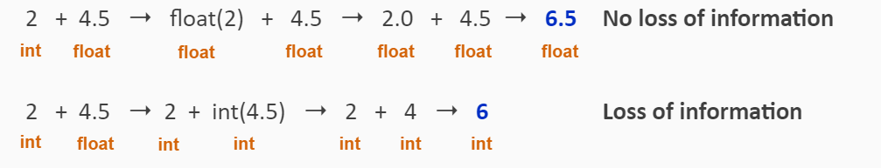
Navigation 7 Expression 7.1 Operator Precedence 7.2 Two Possibilities 7.3 Data Types 7.4 static vs. dynamic typing 7.5 Mixed Type Expression? 7.6 Implicit 7.7 Explicit
7.7 Explicit Conversion (Type Conversion)
Type conversion is the explicit conversion of operands to a specific type. Type conversion can be applied even if loss of information results. Python provides built-in type conversion functions int() and float(), with the int() function truncating results.
01

Slide 59
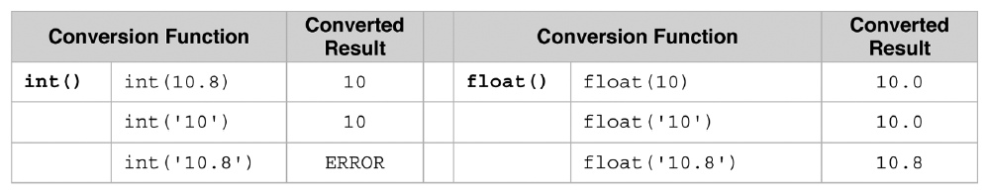
Navigation 7 Expression 7.1 Operator Precedence 7.2 Two Possibilities 7.3 Data Types 7.4 static vs. dynamic typing 7.5 Mixed Type Expression? 7.6 Implicit 7.7 Explicit
Explicit Conversion (Type Conversion)
Type conversion functions int() and float()
01
Note that numeric strings can also be converted to a numeric type. In fact, we have already been doing this when using int or float with the input function,
>>> num_credits = int(input('How many credits do you have? '))

Slide 61
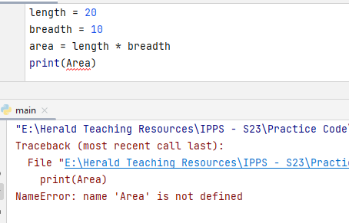
Navigation 7 Expression 7.1 Operator Precedence 7.2 Two Possibilities 7.3 Data Types 7.4 static vs. dynamic typing 7.5 Mixed Type Expression? 7.6 Implicit 7.7 Explicit 8. Bonus Topic
8. Types of Errors
Compile Time Error
01
Syntax Errors
Spelling, Capitalization, punctuation
Ordering of statements, matching of braces/parenthesis…
Correct first error listed, then compile again

Slide 62
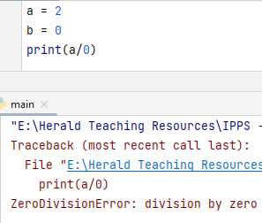
Navigation 7 Expression 7.1 Operator Precedence 7.2 Two Possibilities 7.3 Data Types 7.4 static vs. dynamic typing 7.5 Mixed Type Expression? 7.6 Implicit 7.7 Explicit 8. Bonus Topic
8. Types of Errors
Run Time Error
01
Logical Errors.
Program runs, but produces unintended results.
Program may crash.

Slide 63


